Slide 1
FY21 PROJECTED PROFITABILITY ANALYSIS
College of Business,
LOYOLA UNIVERSITY, NEW ORLEANS

Slide 2
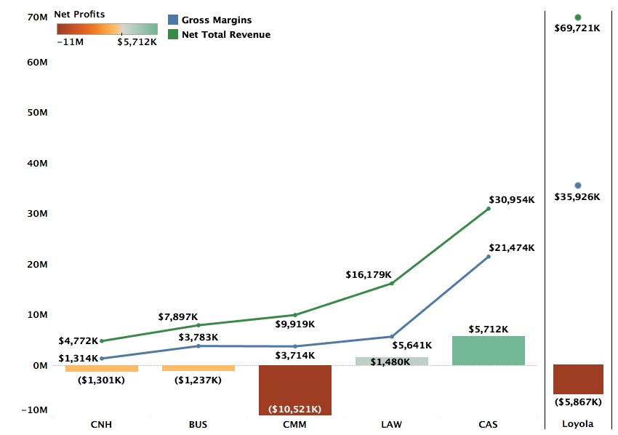
Profitability by College FY21 Projections

Slide 3
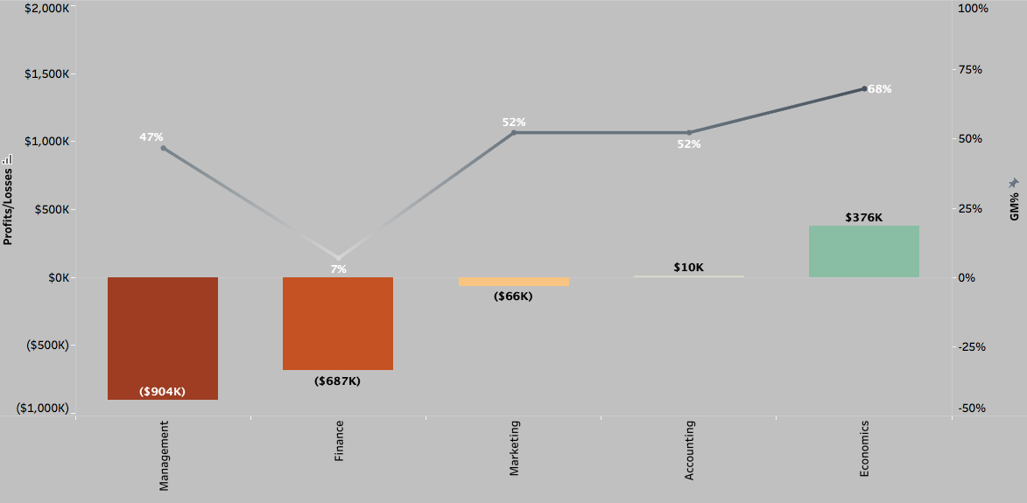
Profitability and GM% by Department (FY21 Projections)

Slide 4
DEFINITIONS
Total Revenue (TR): TR includes revenue for courses taught by the faculty of a department across all three terms, distributed revenue for courses that do not belong to a specific department, and distribution of revenues from courses of programs like Study Abroad that do not have any assigned faculty.
Avg. TR per credit (FY20) for Fall and Spring semesters is $577
Gross Margins (GM): GM = TR – Direct Costs. Direct costs include salaries, operating costs, and fringe benefits.
Avg. GM% for FY20 = 54%
Profitability = GM – Indirect Costs + Indirect Revenues. Indirect costs refer to administration costs, auxiliary costs, or college level costs distributed over departments of the specific college. Indirect revenues include auxiliary revenues, dorm revenues, and revenue from other sources.

Slide 5
Methodology FY21 Projections
FY21 Revenue Projections: Revenue projections are based on Fall 2020 enrollments and projected Spring retention rate. FY20 summer revenues are used as proxy for the FY21 summer term.
Direct Costs: Direct costs include salaries and operating costs from department budgets. FY20 fringe benefits are used as a proxy for FY21 fringe benefits.
Indirect Costs: Indirect costs in FY20 and FY21 have been higher than previous years and is reflected in department-level profitability. FY21 is also estimated to bring in lower Auxiliary revenues.

Slide 6
DEPARTMENTS WITH WORSENING FINANCIAL PERFORMANCE

Slide 7

Finance
Finance had a steep decline in TR in FY20 leading to a big drop in GM from 39% in FY19 to 7% in FY21 due to the largely fixed nature of its direct costs.
Their TR/Credit declined from $619 in FY19 to $475 in FY20. Without a significant change in # credits taken, the TR decline is primarily driven by high discount rates. As such, the strategy to increase enrollments with higher discounts has not paid dividends.

Slide 8
DEPARTMENTS WITH IMPROVING FINANCIAL PERFORMANCE

Slide 9
Management
Management’s TR has seen an increase from FY19 to FY21’s projection, with fluctuations in profitability primarily driven by changes in Gross Margins each year.
The TR/Credit for Management decreased from $544 in FY19 to $528 in FY20 signifying higher than average discount rates

Slide 10
Marketing
A healthy enrollment-driven projected increase in TR for Marketing is likely to reduce the losses for the department to $60K in FY21.
Steeper discount rates seem to correlate with this increase in TR. TR/Credit = $569 in FY19 and $525 in FY20, while # credits increased from 2040 to 2316. This growth will have to be balanced with lower discount rates.

Slide 11
PROFITABLE DEPARTMENTS

Slide 12
Accounting and Economics
Accounting
Economics

Slide 13
Appendix (FY19 and FY20)

Slide 14
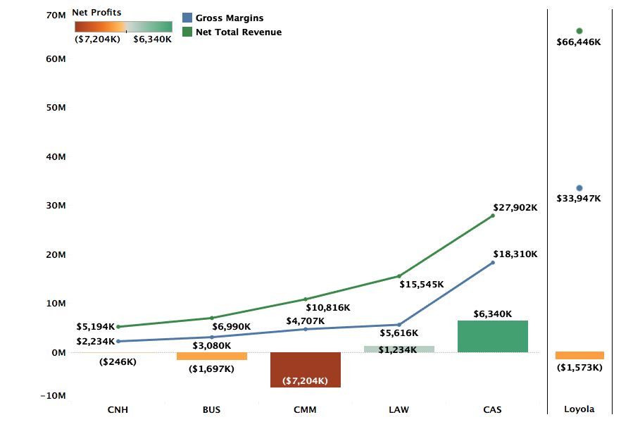
Profitability by College FY20 Actuals

Slide 15
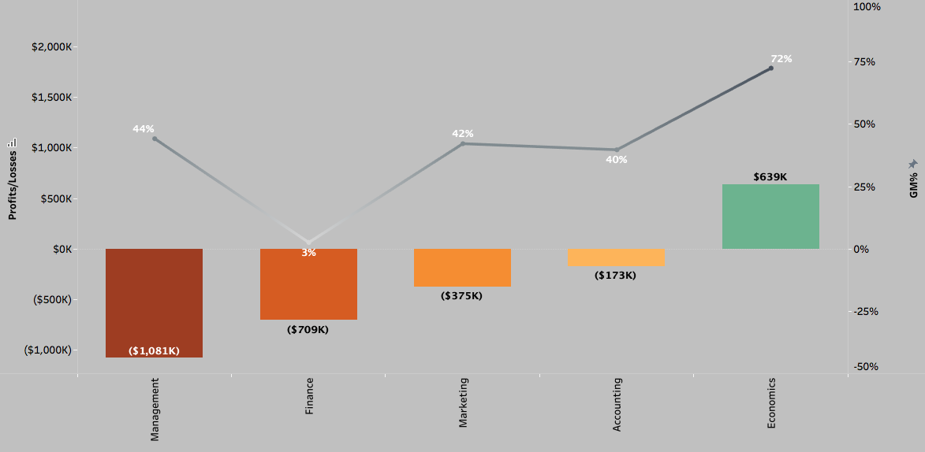
Profitability and GM% by Department (FY20 Actuals)

Slide 16
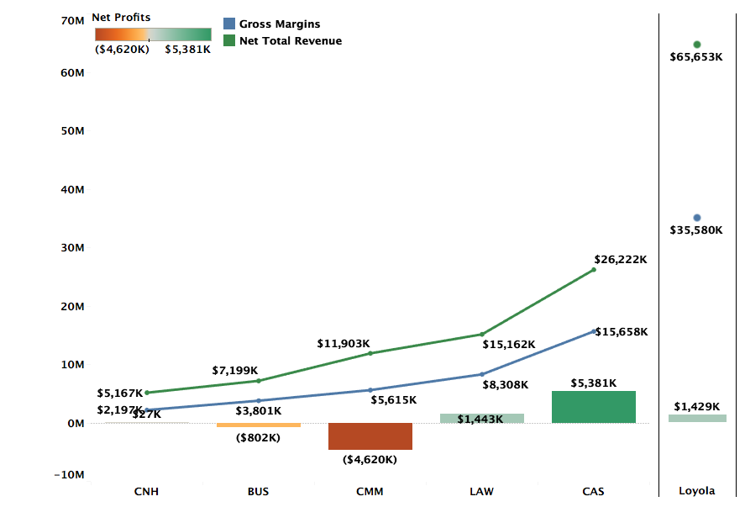
Profitability by College FY19 Actuals

Slide 17
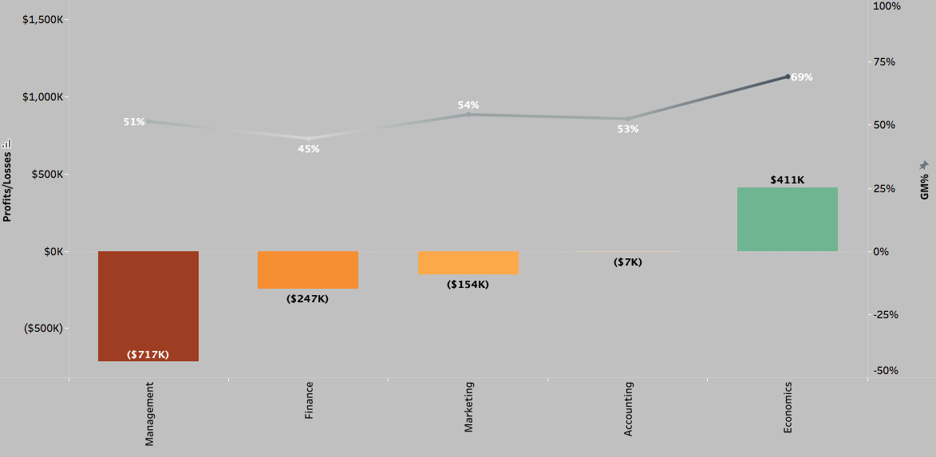
Profitability and GM% by Department (FY19 Actuals)

